Slide 1
P3: Skin Graft Application.
[Project Proposal]

Slide 2
Group Members
Blessy Kuriakose (blessykuriakose@my.unt.edu)
Nick Torres (nicholastorres@my.unt.edu)
Asherpranay Palle (asherpranaypalle@my.unt.edu)
Sruthi Bharath Kumar (sruthibharathkumar@my.unt.edu)
Mica Haney (micahaney@my.unt.edu)
With assistance from Gagan Sai Ram Anvesh Achanta and Abhijit Talluri for project continuation.
Weekly meetings are scheduled for Mondays at 4pm in the classroom. Members who cannot be physically present can arrange to attend via Zoom.

Slide 3
Abstract
“Burn Injuries are one of the most common and devastating afflictions on the human body. Currently, treatments for burns can be effective but rely on estimations of burn area that take time and can be error prone. By improving this process doctors can give better care to patients. In collaboration with the Department Of Surgery at Loyola University Chicago, we have created an application that tackles these issues. With our application, pictures of burn patients will be taken, one from the front and one from the back, skin and burn segmentation will be performed, and then an accurate percentage of the burn area will be calculated. This application would make burn area estimation, skin graft planning, and burn treatment process more precise and efficient for doctors.”
(From P2’s presentation slides)

Slide 4
Overview
In previous works on this project, a cross-platform app was created using Kivy to take an image of the area of interest on which the implemented codes can run. Code has currently been developed to segment out the areas of skin in the image. (This annotation is viewable via the LabelBox platform.)
The dataset used for this iteration task contains web-scraped images of different burn degrees (1, 2, and 3) all annotated using ‘coco format’ to show bounding boxes of the burned area as well as the class/category of the burn degree. (Labels converted from the original yolo format in previous iterations.) [LINK]
For this iteration we will be attempting to segment the burn areas using a U-Net model.

Slide 5

Past works in overview.
Warning: Images may be gruesome. Proceed with caution.
Note: Not all components are shown. This mainly focuses on the results of several large milestones met throughout.

Slide 6
general summary:
Completed
Dataset has been changed to coco-annotations.
LabelBox for segmentation annotations.
Skin segmentation model complete.
Kivy app deployment for skin segmentation on desktop.
To be completed/solved
App crashing. (May need to convert model to less expensive one.)
Difficulty in getting app to work on mobile phones.
Burn segmentation annotations.
Burn segmentation model building.

Slide 7
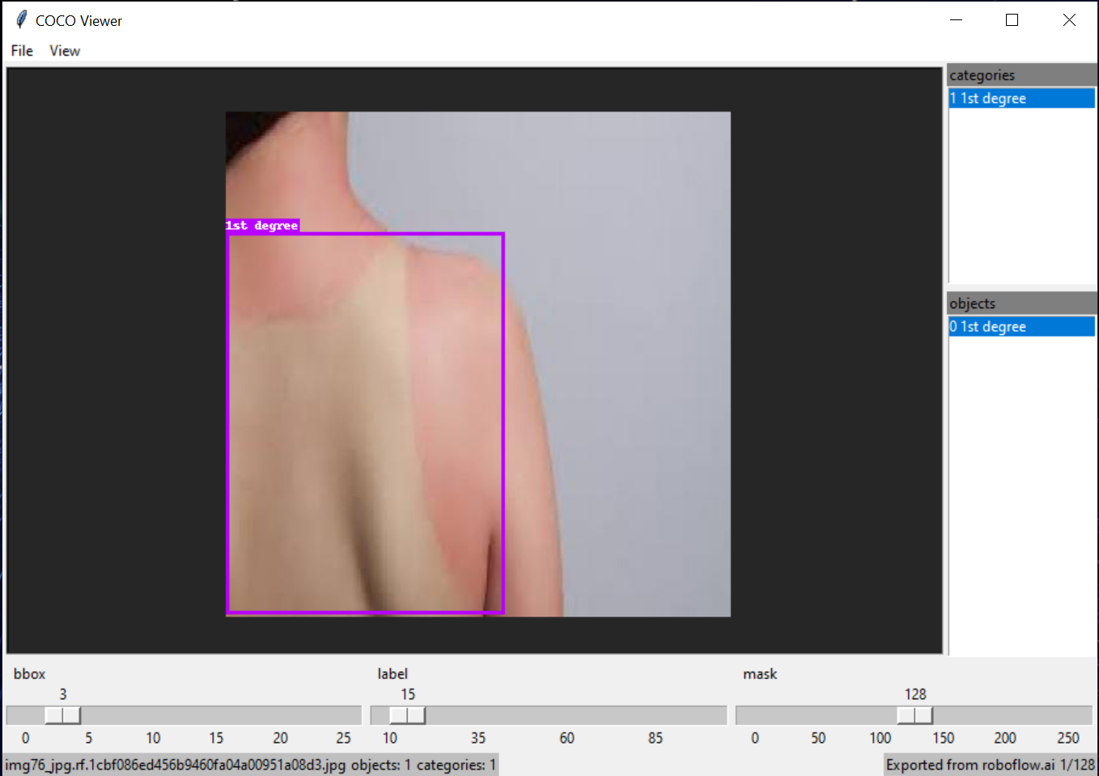
Dataset sample (after coco annotations)
Notes:
Not available without permissions:
https://colab.research.google.com/drive/127xNwfAnyitO3-1BrMzg_SdOFQimLaD4
Instructions to run code via command prompt (Anaconda Prompt in my case) is given in the colab file.

Slide 8
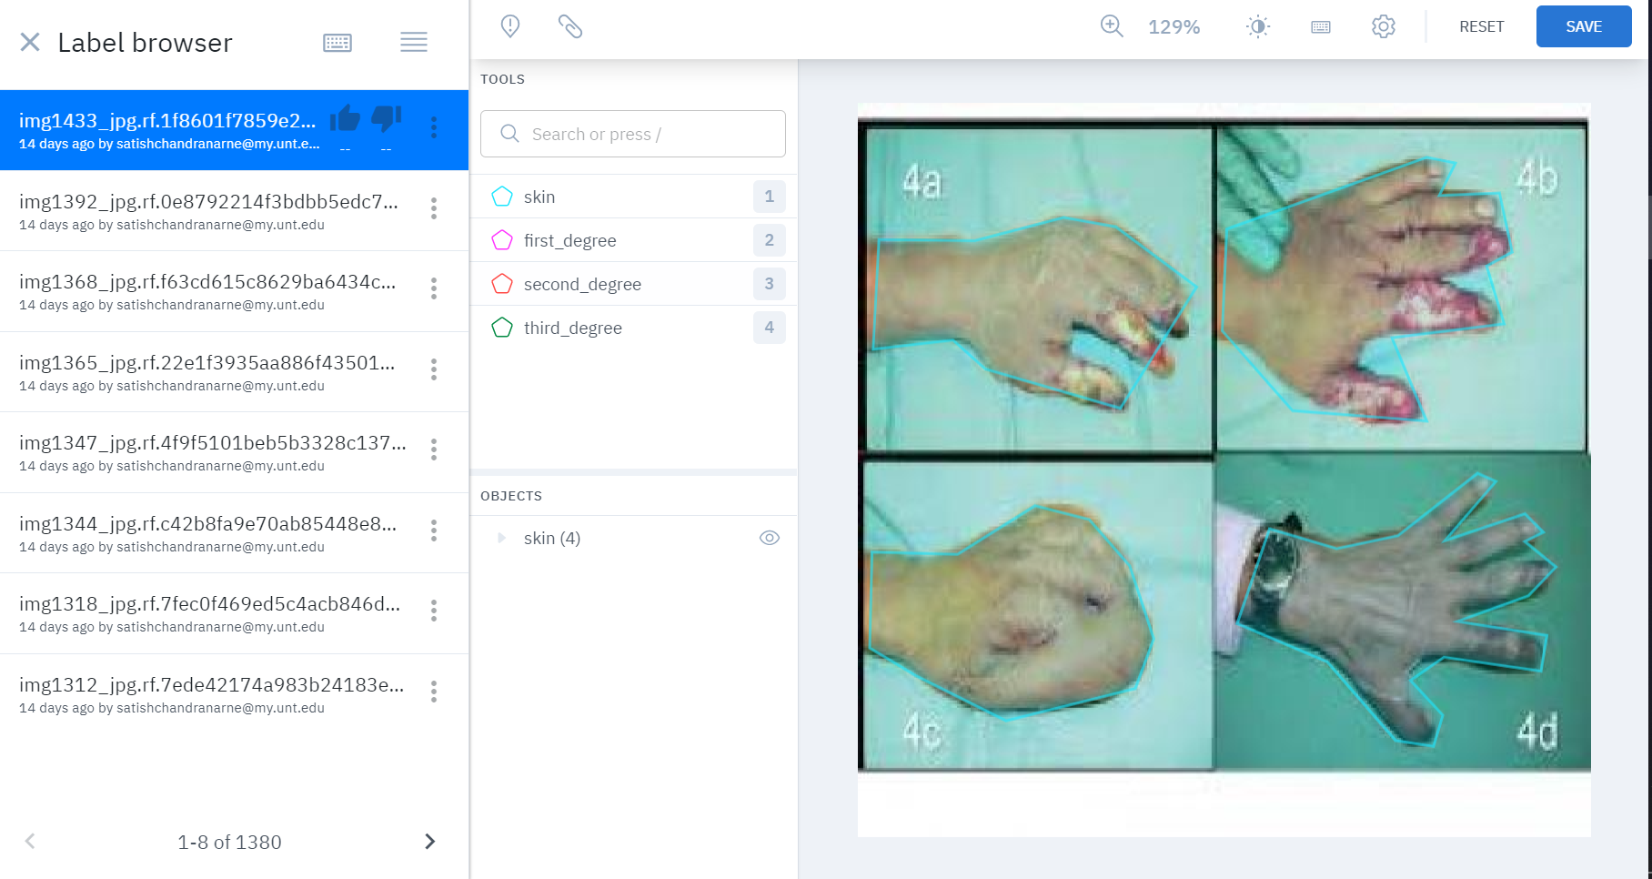
LabelBox skin segmentation annotations.
Notes:
https://app.labelbox.com/signin
Login needed to access files. (owner: Abhijit Talluri)

Slide 9
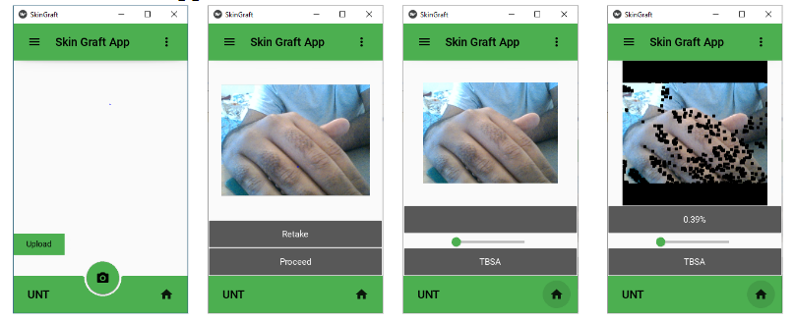
Kivy app implementation. (Copied from P2 presentation slides.)
Notes:
Not available without permissions:
https://drive.google.com/file/d/1hIeQsKH4rw0ieUchZiWE1GKr5hpqusfc/view?usp=share_link
Sample activation via command prompt (/Anaconda Prompt):
(base) C:\Users\trela>cd C:\Users\trela\OneDrive\Desktop\KIVY_app\KIVY_app\kivy_venv\Scripts
(base) C:\Users\trela\OneDrive\Desktop\KIVY_app\KIVY_app\kivy_venv\Scripts>activate.bat
(base) C:\Users\trela>cd C:\Users\trela\OneDrive\Desktop\KIVY_app\KIVY_app
(base) C:\Users\trela\OneDrive\Desktop\KIVY_app\KIVY_app>pip install -r requirements.txt
(base) C:\Users\trela\OneDrive\Desktop\KIVY_app\KIVY_app>python skin_graft_v5.py

Slide 10
Works/Milestones to come.
Burn annotations.
UNet model creation.
Model training.
Model testing.
Report and presentation. (Due 11/30)
Handover to original team (from summer): Gagan Sai Ram Anvesh Achanta and Abhijit Talluri.
*If time permits we may attempt to do some integrations, but our focus will be on the burn segmentation tasks as given in the milestones.

Slide 11
Resources.
https://app.labelbox.com: for annotations used for supervised learning.
Kivy: for cross-platform app creation.
Colab: for initial code implementation, testing, and collaborations.
https://universe.roboflow.com/yingcai/skin_burn_detection: for original dataset.
> Other resources include standing members from the initial project (from summer) as denoted in the ‘Group Members’ slide.
Related Works: “This project is an incremental work done during the summer research program… A drive link for the poster that was submitted over the summer is attached here.” (From P2 presentation slides.)

